Slide 1
State Modeling

Slide 2
Events
An event is an occurrence at a point in time, such as user depresses left button or Air Deccan flight departs from Bombay.
One event may logically precede or follow another, or the two events may be unrelated
Events include error conditions as well as normal conditions. example, motor jammed, transaction aborted
Three types of events : signal event, change event and time event

Slide 3
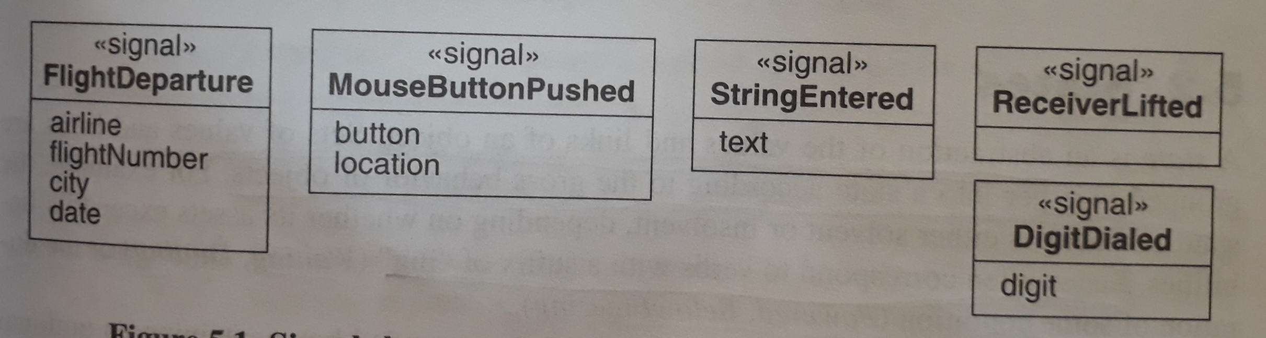
Signal Event
A signal is an explicit one-way transmission of information from one object to another.
A signal event is the event of sending or receiving a signal
A signal is a message between objects whereas a signal event is an occurrence in time

Slide 4
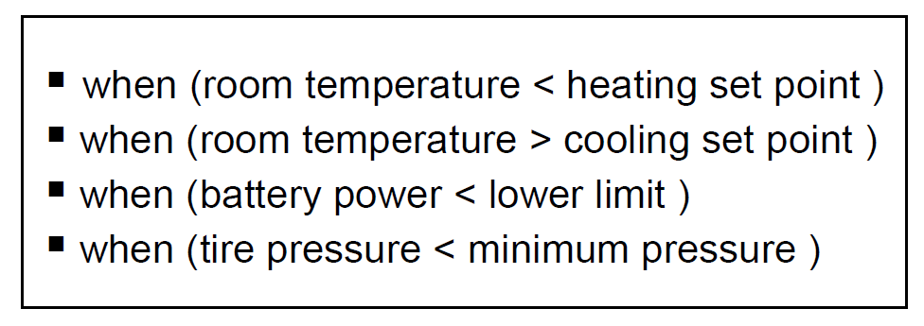
Change Event
A change event is an event that is caused by the satisfaction of a Boolean expression
The intent of a change of event is that the expression is continually tested
UML notation for a change event is keyword “when” followed by a parenthesized Boolean expression

Slide 5
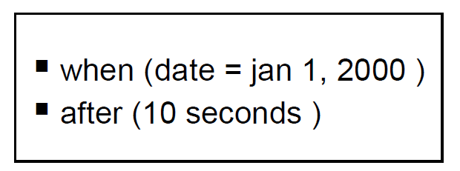
Time Event
Time event is an event caused by the occurrence of an absolute time or the elapse of a time interval
UML notation for an absolute time is the keyword “when “followed by a parenthesized expression involving time.
The notation for a time interval is the keyword “after” followed by a parenthesized expression that evaluates to a time duration

Slide 6
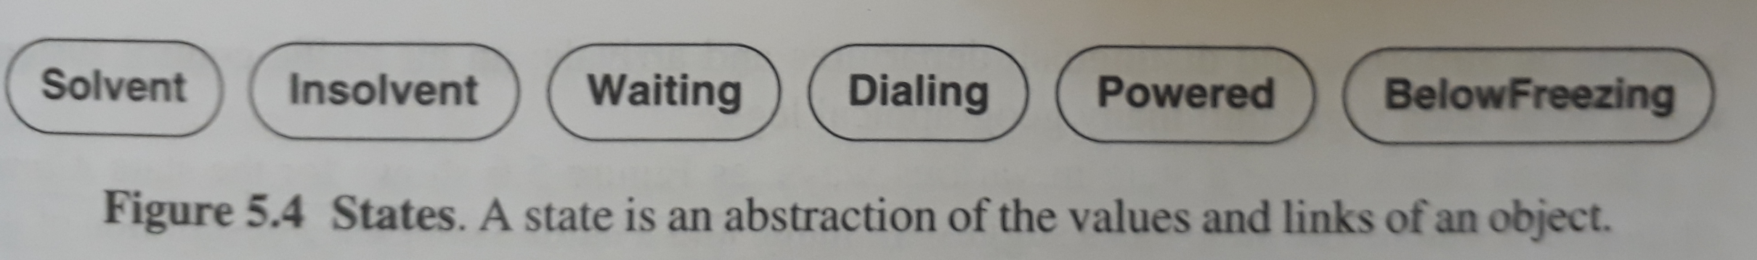
States
A state is an abstraction of the values and links of an object
Sets of values and links are grouped together into a state according to the behavior of objects
Event represents points in time whereas State represents intervals of time.

Slide 7
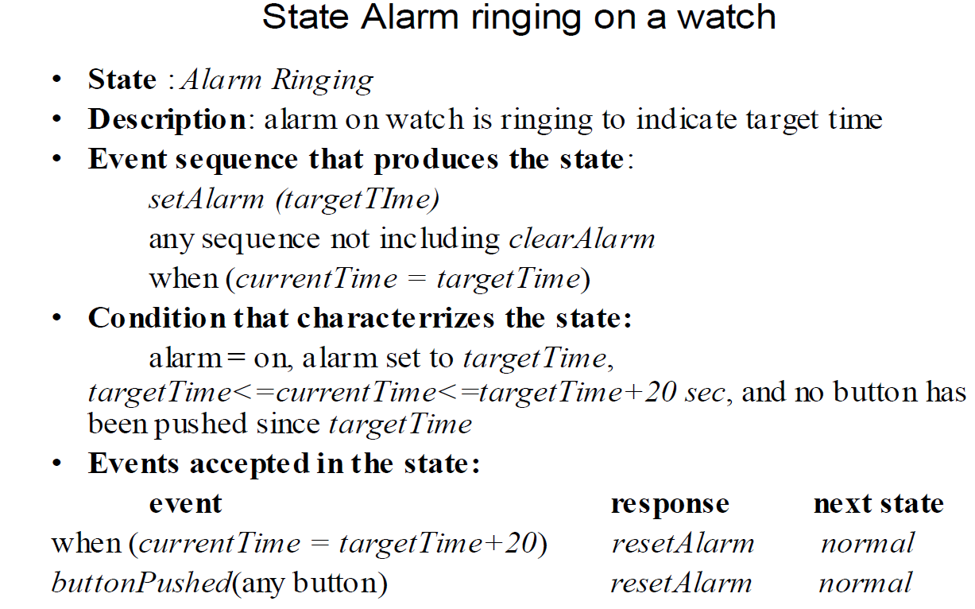
States

Slide 8
Transitions & Conditions
A transition is an instantaneous change from one state to another
The transition is said to fire upon the change from the source state to target state.
A transition fires when its events occurs.
A guard condition is a Boolean expression that must be true in order for a transition to occur.
A guard condition is checked only once, at the time the event occurs, and the transition fires if the condition is true

Slide 9
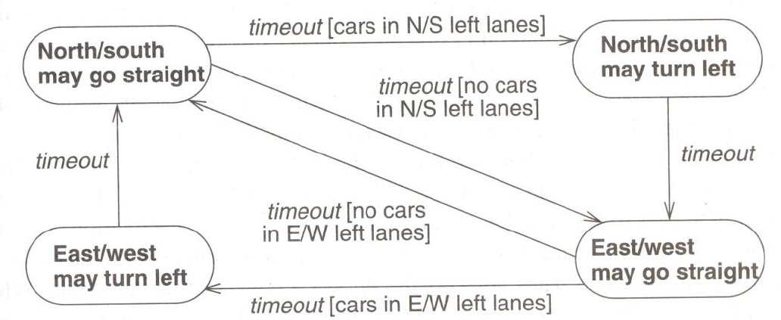
Transitions & Conditions

Slide 10
State Diagram
A state diagram is a graph whose nodes are states and whose directed arcs are transitions between states
State names must be unique within the scope of a state diagram
A state model consists of multiple state diagrams one state diagram for each class with important temporal behavior

Slide 11
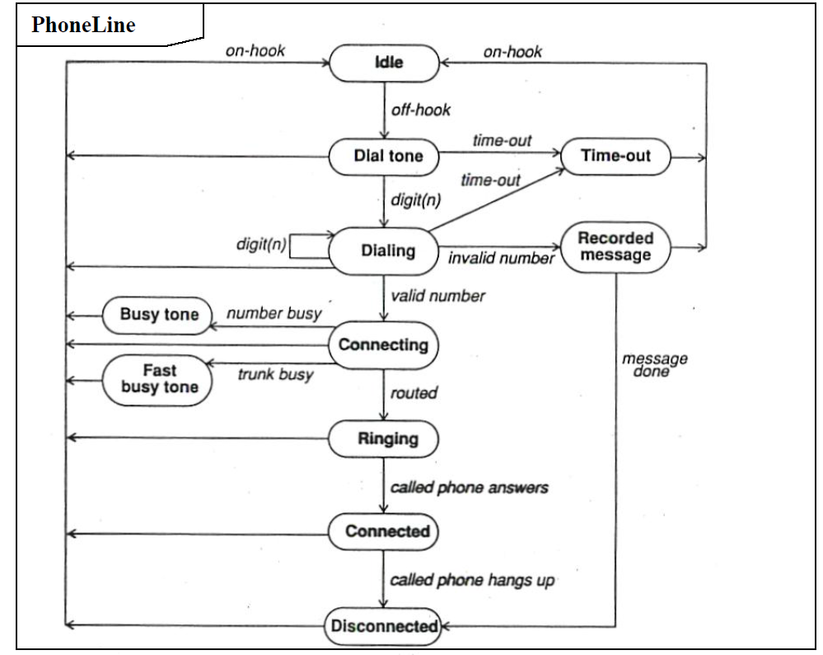
State Diagram

Slide 12
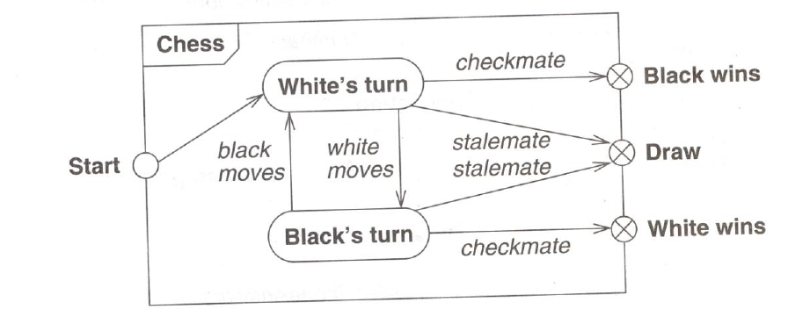
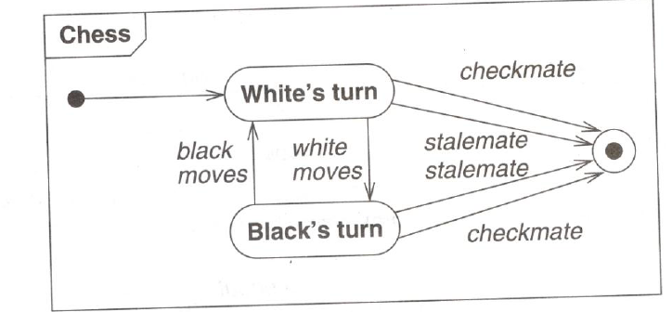
One shot state diagrams
One-shot state diagrams represent objects with finite lives/continuous loops and have initial and final states.

Slide 13
State Diagram Behavior
Activity Effects
An effect is a reference to a behavior that is executed in response to an event
An activity is the actual behavior that can be invoked by any number of effects
The notation for an activity is a shash (“/”) and the name of the activity
The keyword “do” is reserved for indicating an ongoing activity

Slide 14
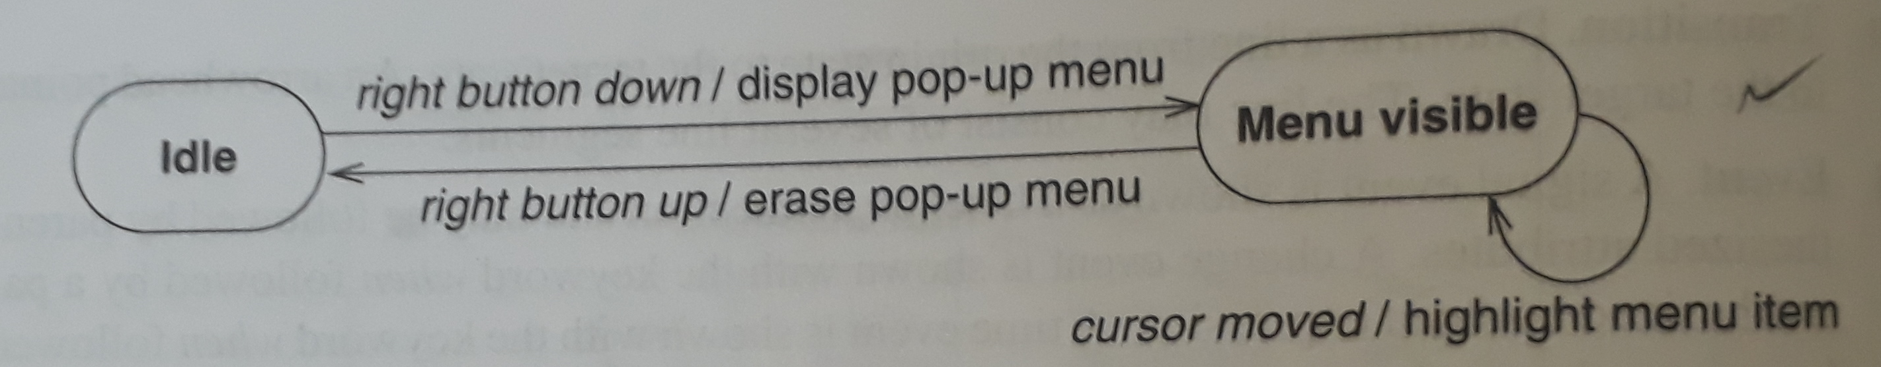
State Diagram Behavior

Slide 15
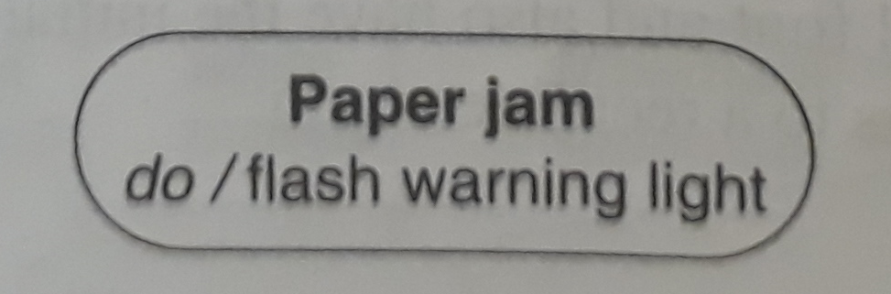
State Diagram Behavior
Do-Activities
Do-activity is an activity that continues for an extended time.
Do-activity can only occur within a state and cant be attached to a transition
Do-activity includes continuous operations, such as displaying a picture on a television screen and so on

Slide 16
Advanced state modeling
Nested state diagram
Problem with flat state diagrams
State diagram have often been criticized because they are impractical for large problems
Consider an object with “n independent” Boolean attributes that affect control

Slide 17
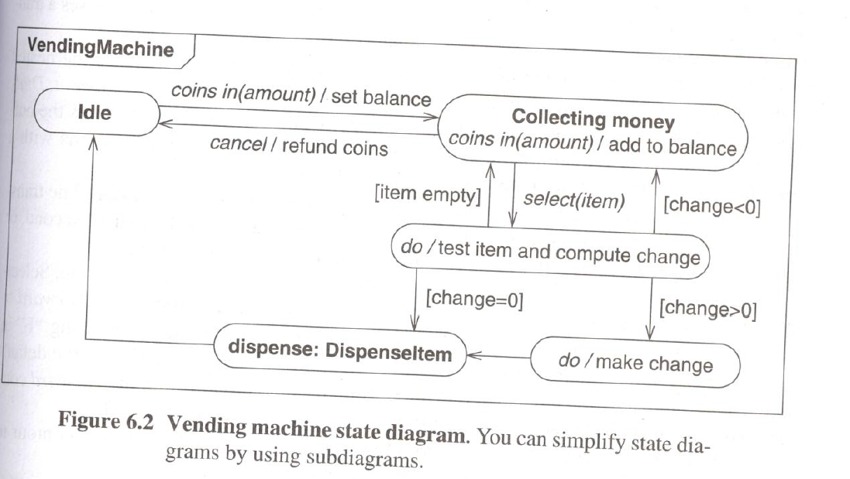
Advanced state modeling
Expanding states
One way to organize a model is by having high level diagram with sub diagrams expanding certain state.

Slide 18
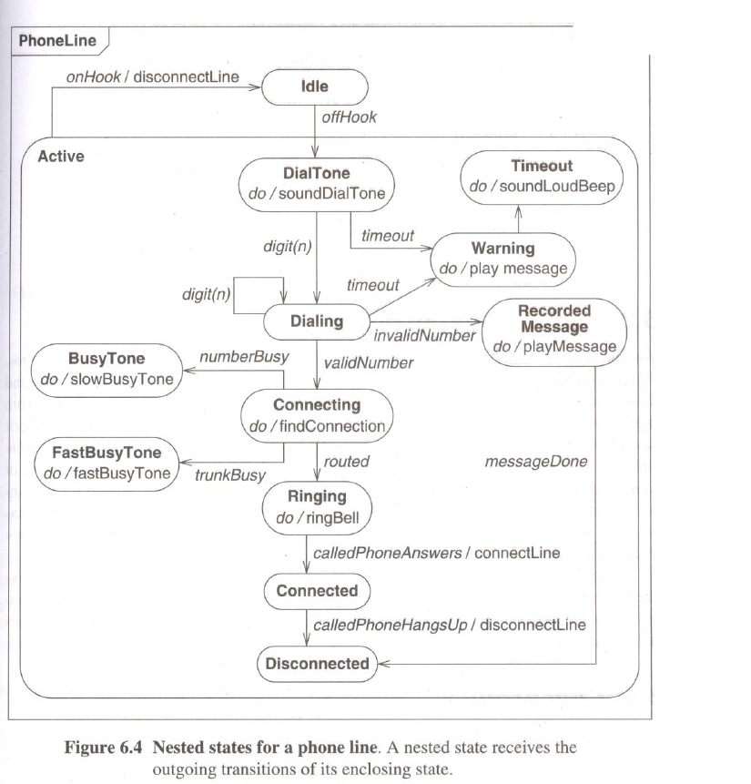
Nested states

Slide 19
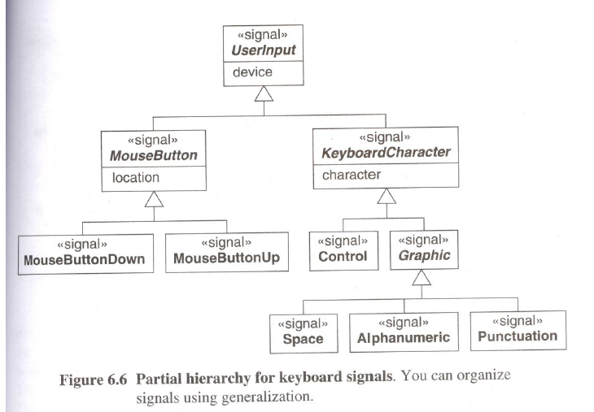
Signal generalization

Slide 20
Concurrency
objects are autonomous entities that can act and change state independent of one another
Aggregation concurrency
Aggregation is the “and-relationship”
The aggregate state is one state from the first diagram, and a state from the second diagram and a state from other diagram

Slide 21
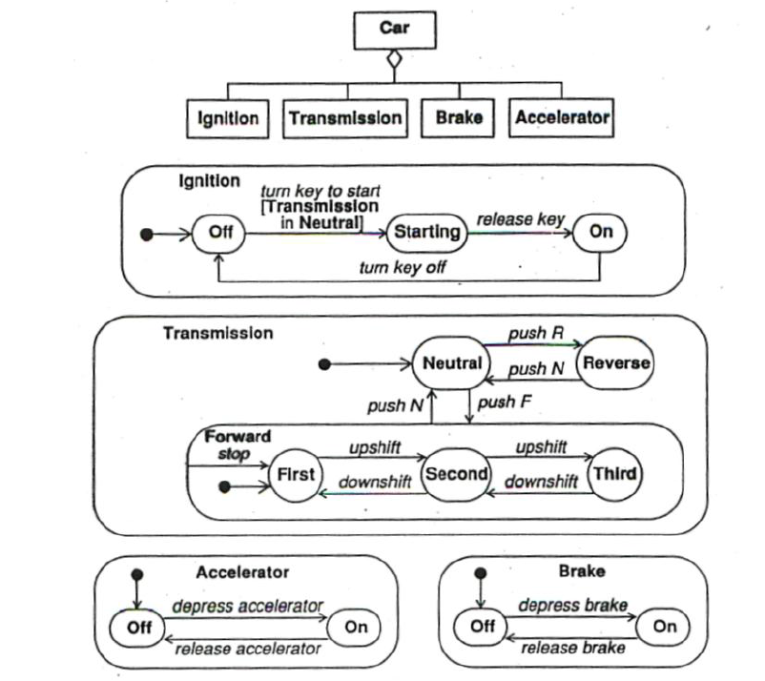
Concurrency

Slide 22
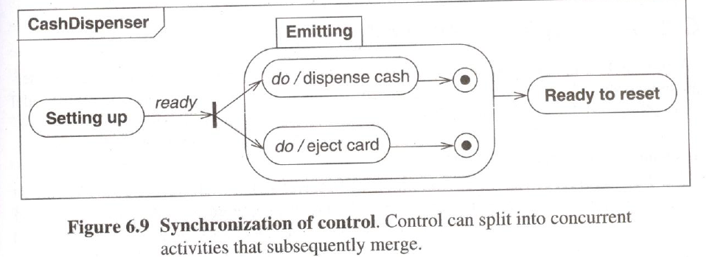
Concurrency
synchronization of concurrent activities
One object must perform two activities concurrently
The object doesn’t synchronize the internal steps of the activities but must complete both activities before progress to its next level

Slide 23
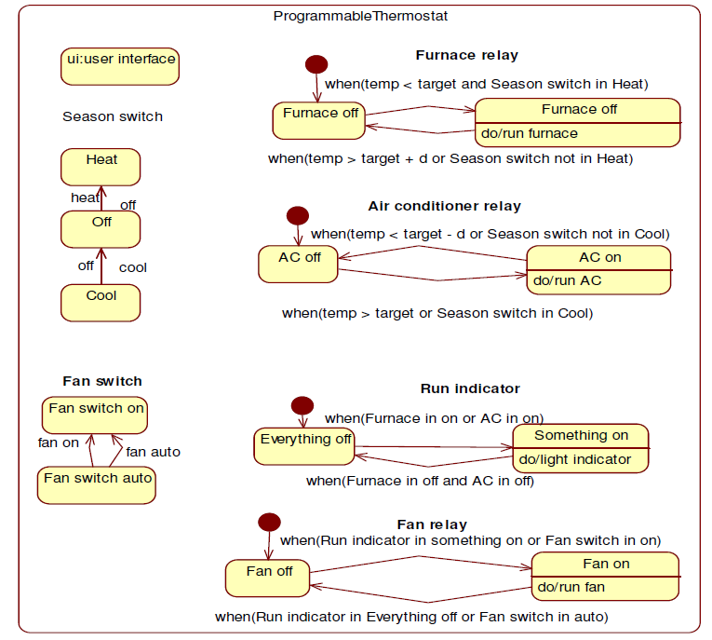
A Sample State Model

Slide 24
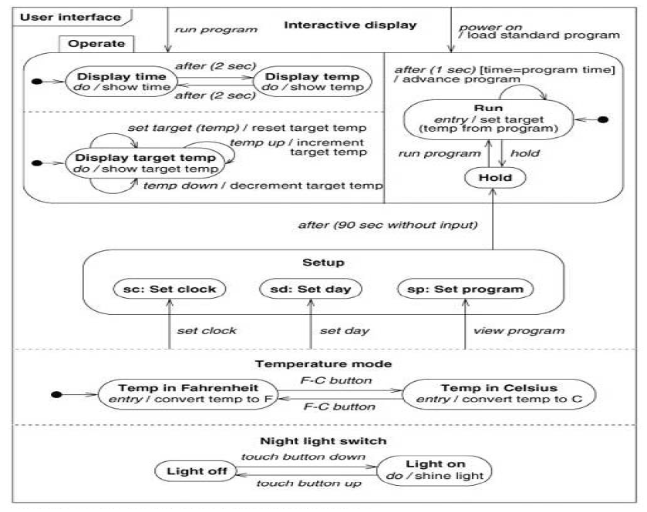
A Sample State Model

Slide 25
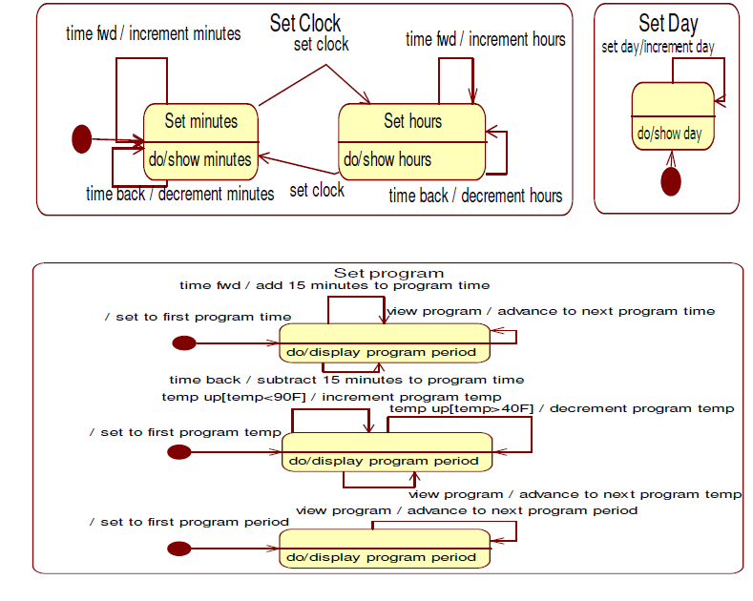
A Sample State Model

Slide 26
Interaction Modeling
The interaction model describes how the objects interact
Interactions can be modeled at different levels of abstraction
Use case model
Sequence model
Activity model

Slide 27
Use case model
Use Case Models – Actors
An actor is a direct external user of a system.
Each actor represents those objects that behave in a particular way toward the system
Example 1) Travel agency system: Actors are - traveler, agent, and airline Example 2) Vending machine: Actors are - Customer, repair technician
An object can be bound to multiple actors if it has different facts to its behavior.

Slide 28
Use case model
Use Case Models - Use Cases
A use case is a coherent piece of functionality that a system can provide by interacting with actors
Example:
A customer actor can buy a beverage from a vending machine
Repair technician can perform scheduled maintenance on a vending machine.

Slide 29
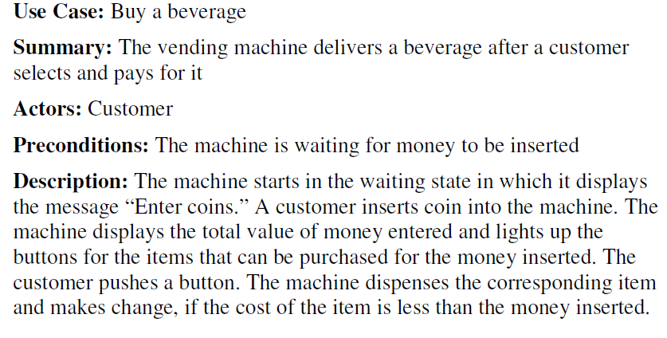
Use case model
Use case description

Slide 30
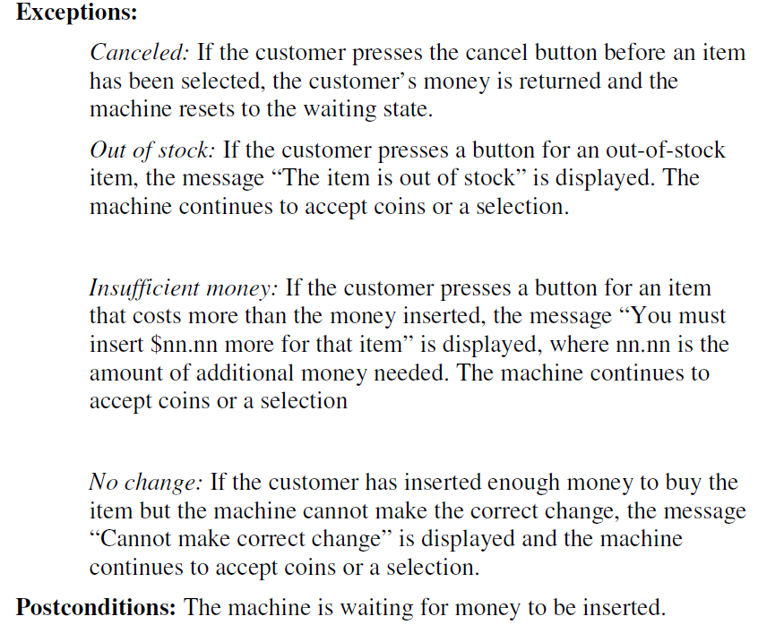
Use case model contd..

Slide 31
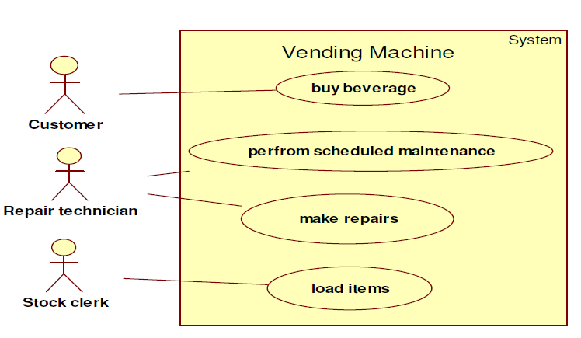
Use case model
Use Case Diagrams
A system involves a set of use cases and a set of actors

Slide 32
Use case model
Guidelines for Use Case Models
First determine the system boundary
Ensure that actors are focused : actor should have a single, coherent purpose
Each use case must provide value to users: For example, dial a telephone number is not a good use case for a telephone system
Relate use cases and actors: every actor should have at least one use case
Remember that use cases are informal

Slide 33
Sequence Models
Two kinds of sequence models
scenarios
sequence diagrams
Scenario
A scenario is a sequence of events that occurs during one particular execution of a system

Slide 34
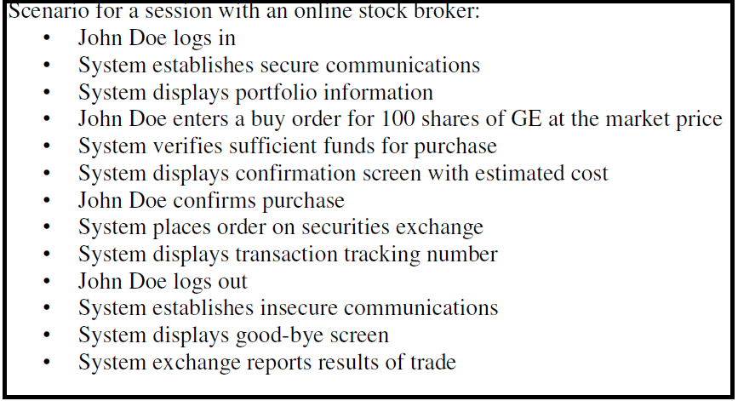
Sequence Models

Slide 35
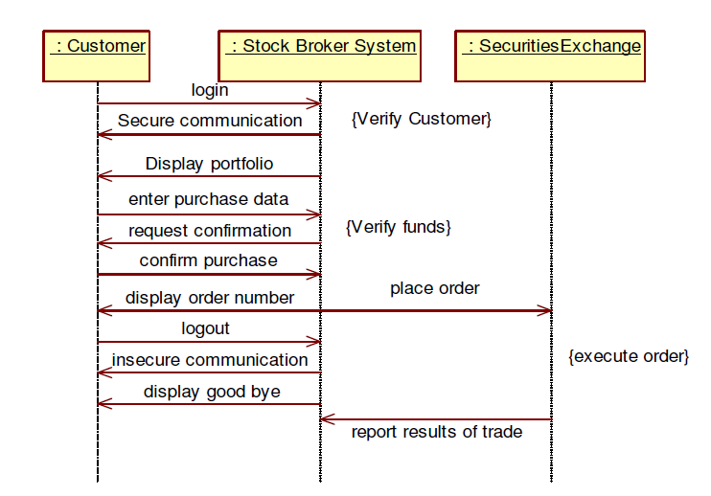
Sequence Models
Sequence diagram

Slide 36
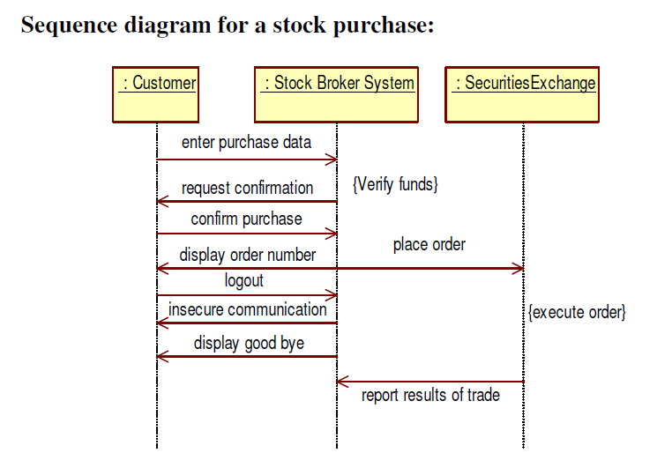
Sequence Models

Slide 37
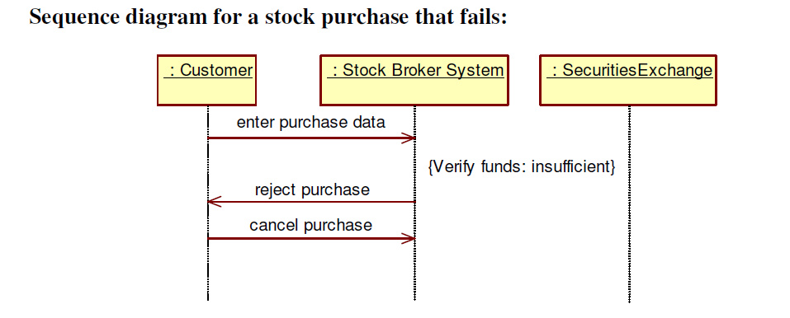
Sequence Models

Slide 38
Activity Models
An activity diagram shows the sequence of steps that make up a complex process, such as algorithm or workflow
Activity diagram shows flow of control similar to sequence diagram but focuses on operations rather than on objects
Activity diagram is like traditional flowchart in that it shows the flow of control from step to step

Slide 39
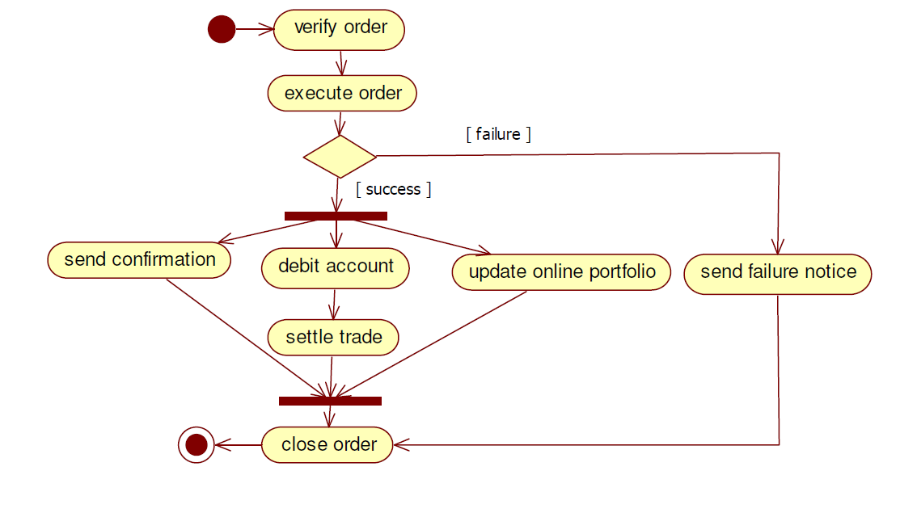
Activity Models

Slide 40
Activity Models
Activities
The purpose of an activity diagram is to show the steps within a complex process and the sequencing constraints among them
Some activities run forever until an outside event interrupts them
Most of the activities complete their work and terminate by themselves
The unlabeled arrow from one activity to another diagram indicates that first activity must complete before the second begins

Slide 41
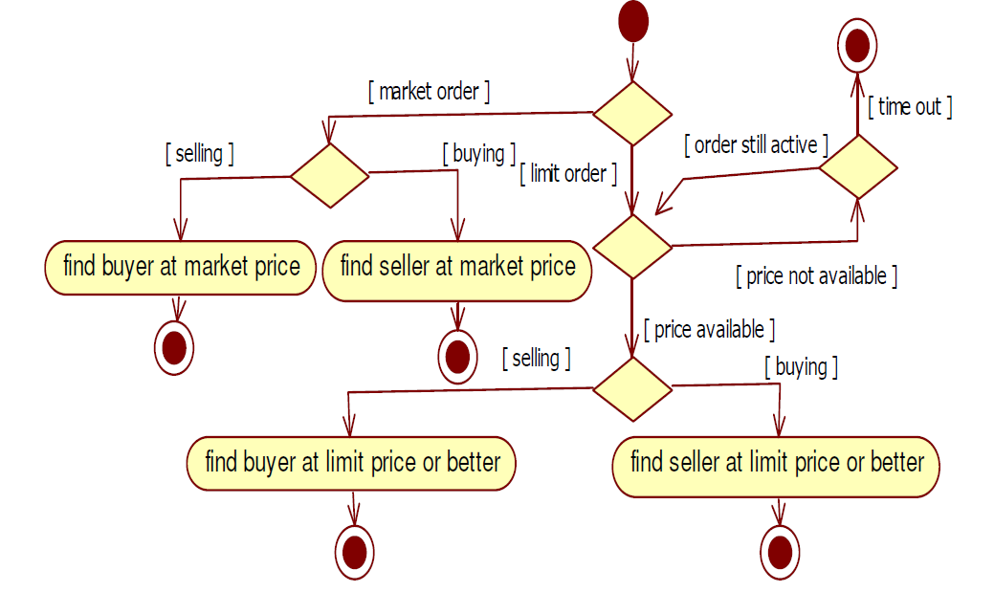
Activity Models

Slide 42
Activity Models
Branches
If there is more than one successor to an activity, each arrow must be labeled with a condition in square bracket
Initiation and Termination
A solid circle with an outgoing arrow shows the starting point of an activity diagram
A bull’s eyes shows the termination point
Concurrent Activities
Concurrency means that the activities can complete in any order and still yield an acceptable result

Slide 43
Activity Models
Executable Activity Diagrams
Activity diagram can also be used to show the progression of control during execution
Activity token can be used to indicate which activity is being executed

Slide 44
Advanced Interaction Modeling
Use Case Relationships
Complex use cases can be built from smaller pieces with the following relationships:
include
extend
Generalization

Slide 45
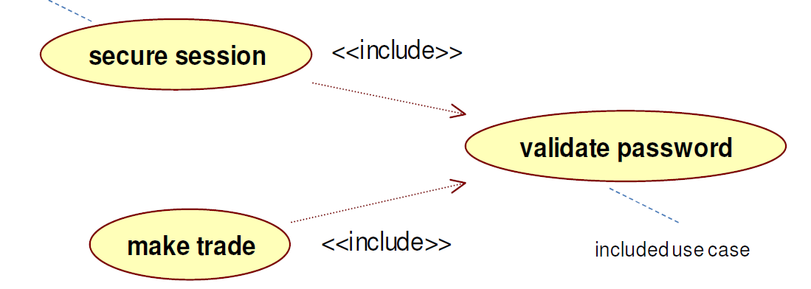
Use Case Relationships
include Relationship
The include relationship incorporates one use case within the behavior sequence of another use case
The keyword <<include>> annotates the arrow

Slide 46
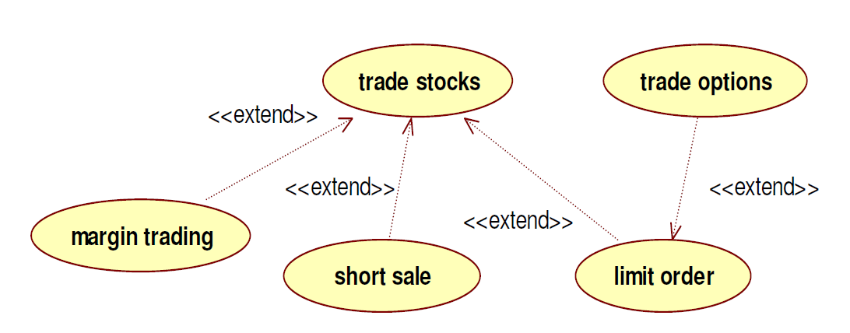
extend Relationship
The extend relationship adds incremental behavior to a use case
It represents the frequent situation in which some initial capability is defined, and later features are added modularly
The keyword <<extend>> annotates the arrow

Slide 47
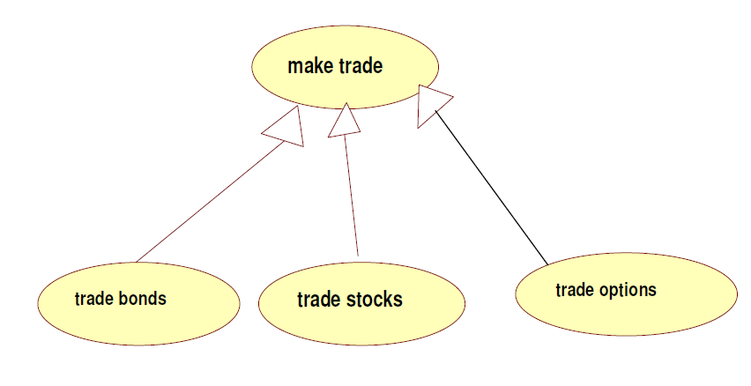
Use cases – Generalization

Slide 48
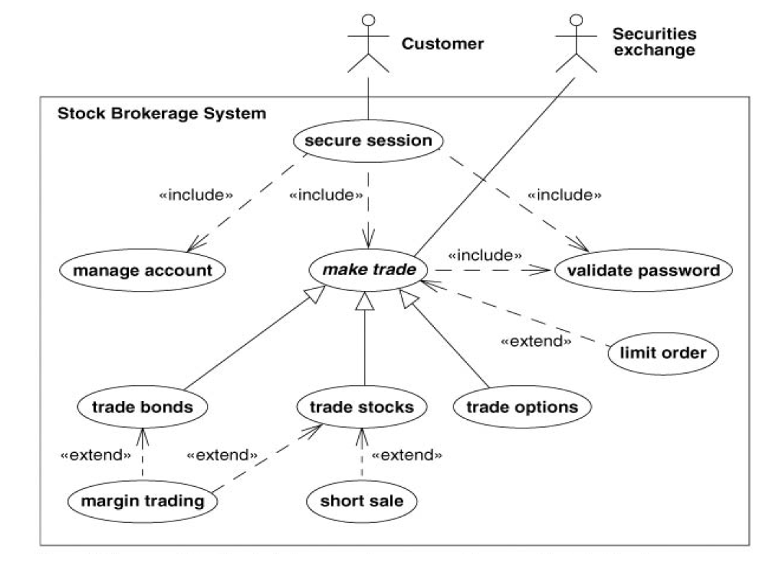
Combinations of the Use Case Relationships

Slide 49
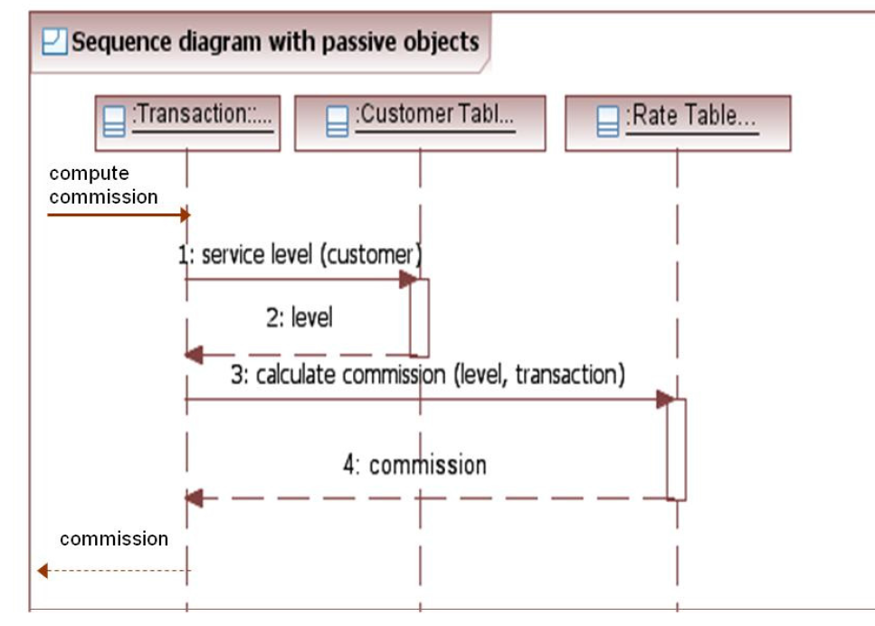
Procedural sequence models
Sequence Diagrams with Passive Objects

Slide 50
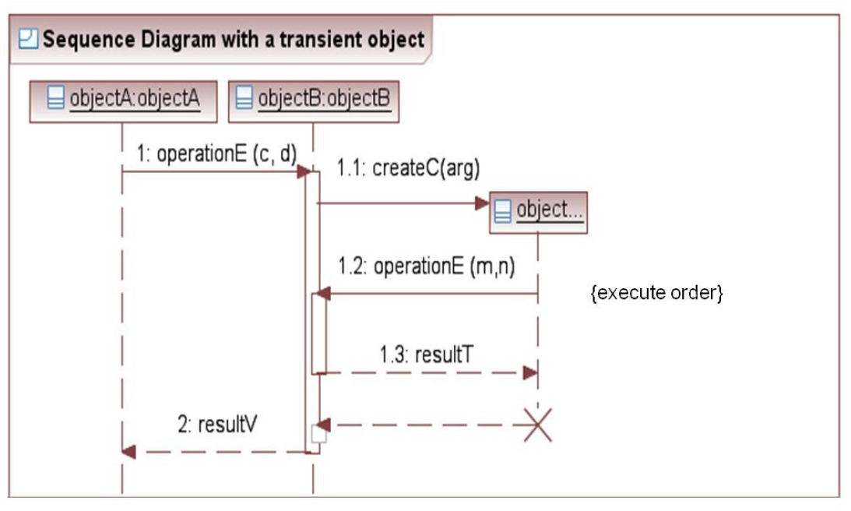
Procedural sequence models
Sequence Diagrams with Transient Objects

Slide 51
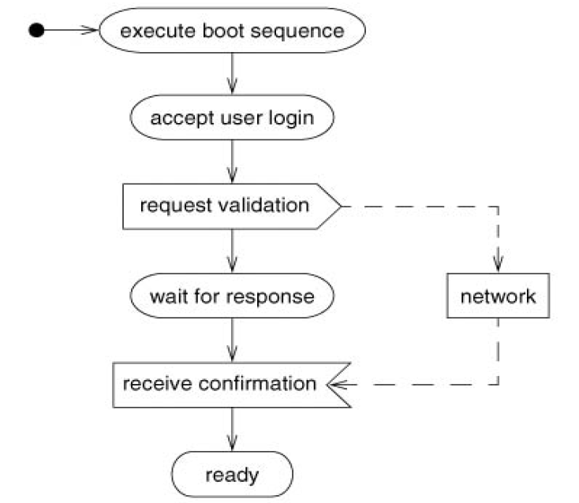
Special Constructs for Activity Diagram
Sending and Receiving Signals

Slide 52
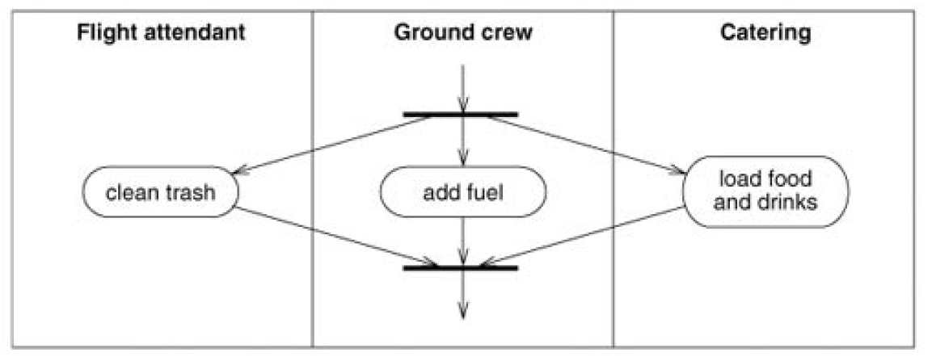
Special Constructs for Activity Diagram
Swimlanes

